Slide 1

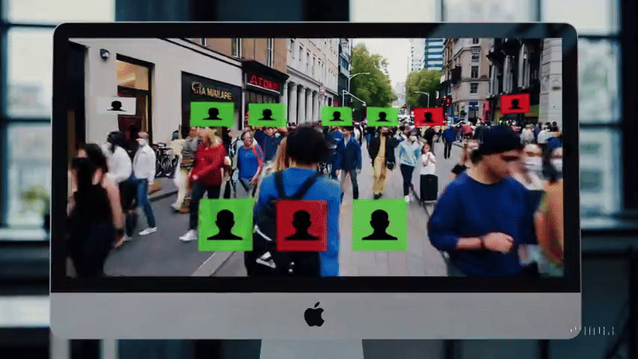
Comparative Study of Convolutional Neural Networks for Real- Time Face Mask Detection CS615 – Final Project​ Winter 24-25​ ​
March 20, 2025
By
Chhattu​ Roy Rajni​ Gandha Tim Kunyz​ Yateen Sakhare

Slide 2

AGENDA
Introduction
Core Challenge
Previous Research
Model Architecture Strategy
Dataset & Feature Extraction
Experimental Data Overview
Result Interpretation
Future Work

Slide 3
Problem Statement
The COVID-19 pandemic emphasized the need for proper mask usage to prevent virus spread. Manual monitoring is impractical in crowded spaces.
Manual enforcement is challenging and inefficient.
Need for an AI-powered solution that can automatically detect if a person is wearing a mask in real-time.
Helps in enforcing mask mandates in public areas, workplaces, and transportation hubs.
The goal is to develop a lightweight and efficient CNN-based model that can run in real-time on edge devices or webcams.
The system should provide real-time alerts (such as beeping) when a person without a mask is detected.
Goals of the Project
Build a real-time face mask detector

Slide 4
Related Work
CNN Evolution: LeNet-5 (1998) pioneered CNNs, AlexNet (2012) expanded their potential, and ResNet (2016) solved deep network limitations.
Face Detection Advances: HaarCascade (2001) enabled fast detection, MTCNN (2016) refined multi-stage learning, and YOLO (2016) revolutionized real-time object recognition.
Mask Detection Optimization: Loey et al. (2021) introduced hybrid CNN models, Wang et al. (2021) optimized MobileNetV2 for mobile deployment, and Papers WithCode (2023) benchmarked state-of-the-art solutions.
1998
2001
2021
1998
2001
2021

Slide 5
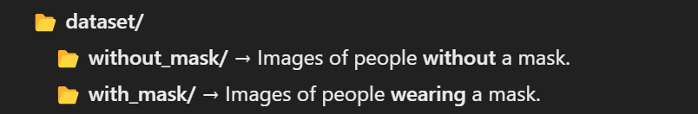
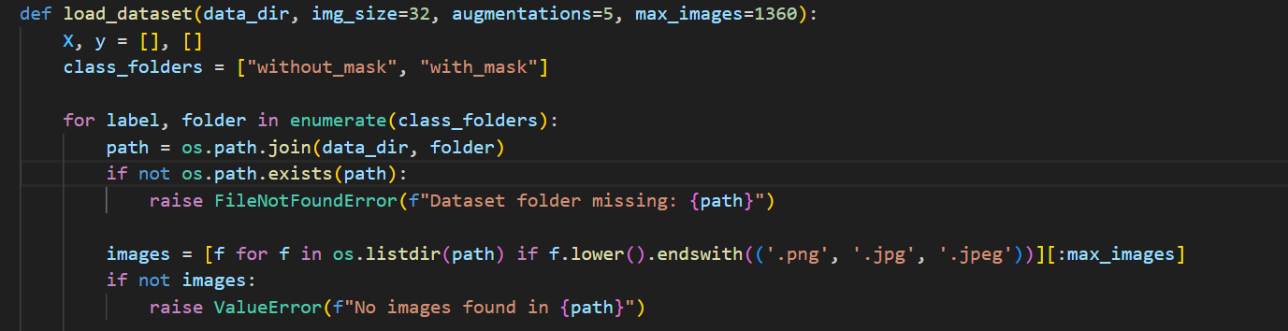
Data Source
Each folder contains a JPEG
Download from Kaggle
1360 data input to the model
Dataset Folder Check in Code

Slide 6
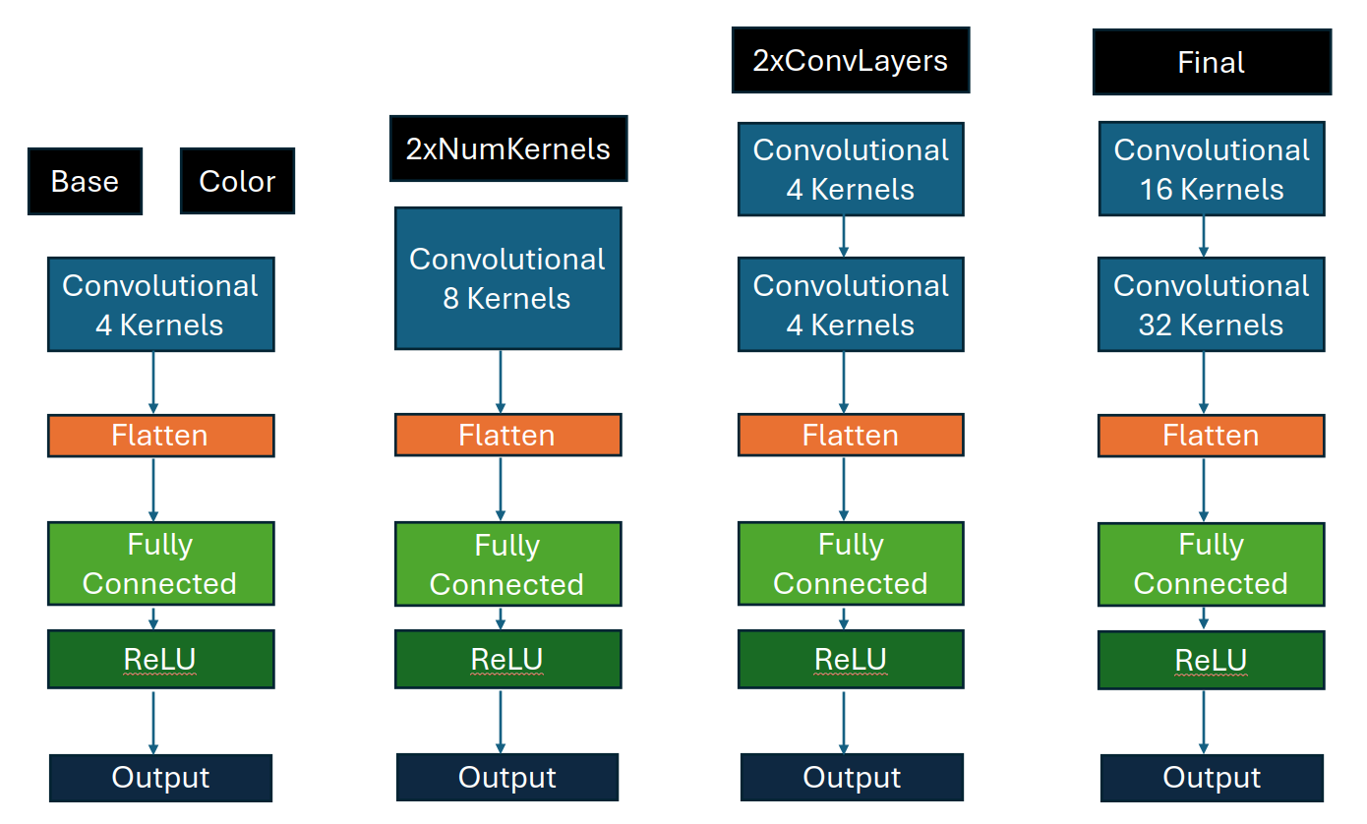
Basic approach
Architectures
Dataset Handling
Custom CNN Architecture
Training
Evaluation
Real-Time Mask Detection
Why This Architecture?​
Custom CNN Instead of Pre-Trained Models
Shallow Network for Small Dataset
ReLU for Non-Linearit
Max Pooling for Downsampling
Softmax for Multi-Class Classification

Slide 7
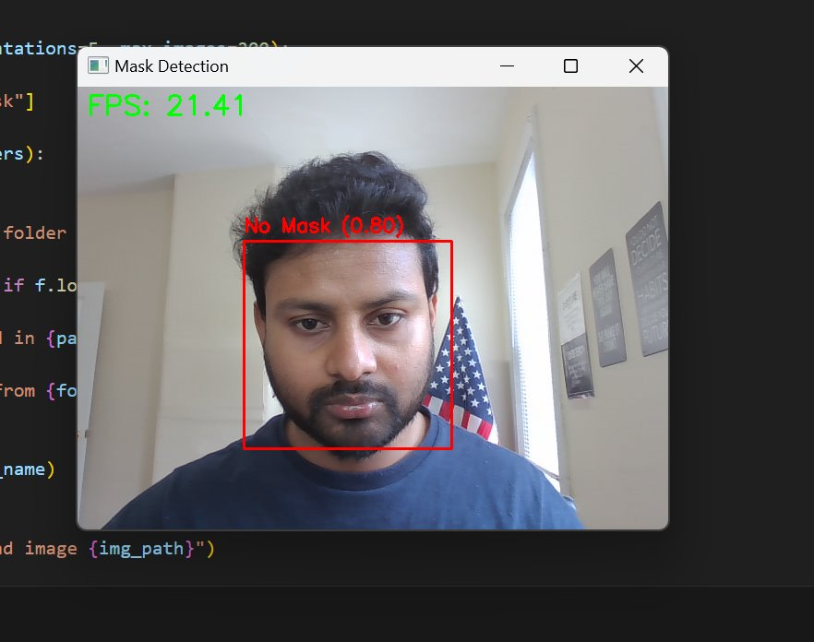
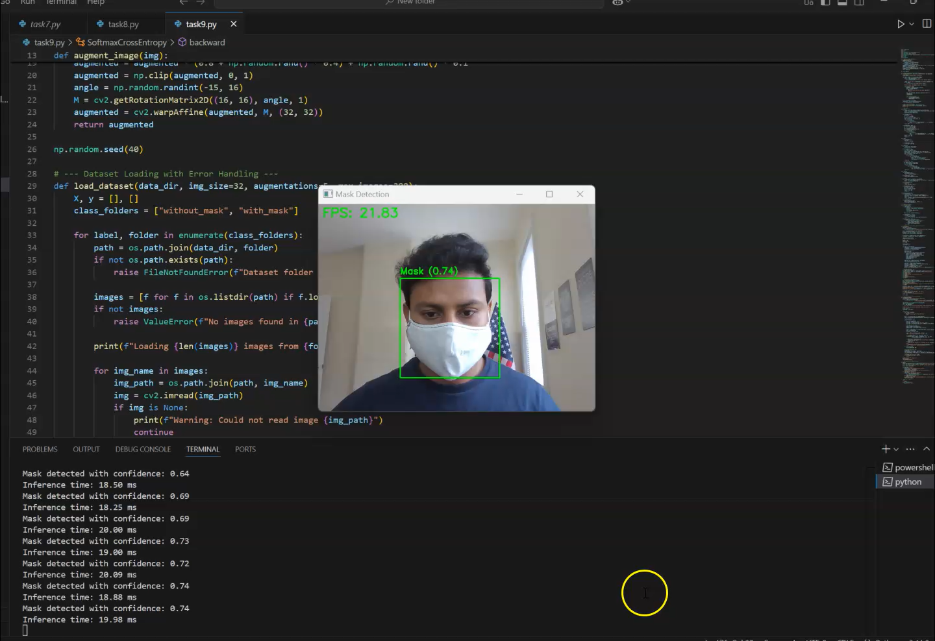
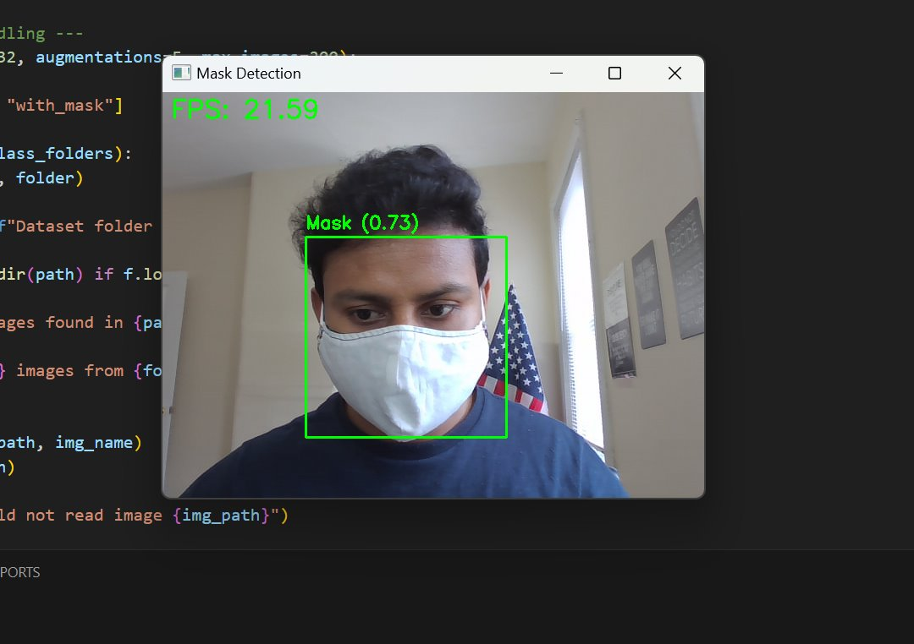
Observations and Demo
Without mask
With Mask

Slide 8
Model Comparison
CNN Variants Performance Overview:
Model | Accuracy | Inference Time (ms) | F1-Score
Grayscale CNN | 89.2% | 12.3 | 0.88
Color CNN | 93.7% | 15.7 | 0.90
Multi-Kernel CNN | 83.4% | 18.4 | 0.80
Multi-Layer CNN | 85.1% | 25.2 | 0.81

Slide 9
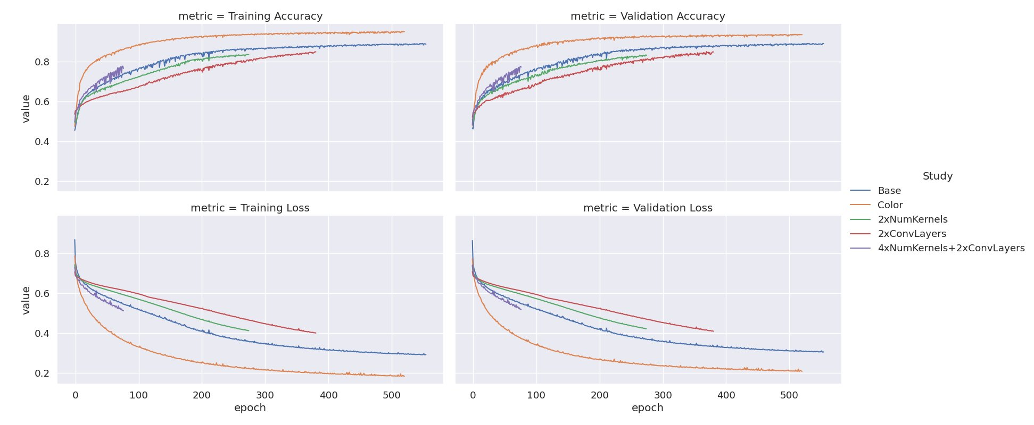
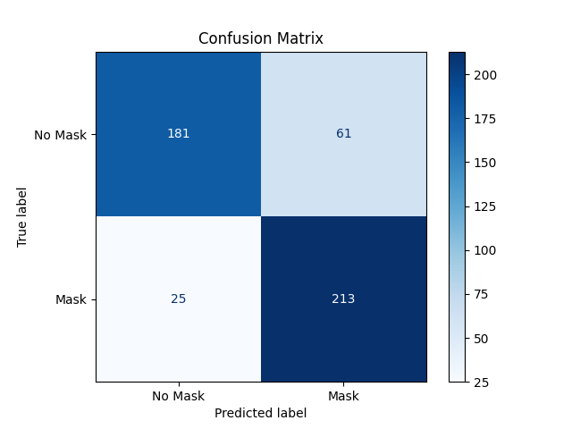
Results – Performance- Observation
Confusion Matrix
Surprisingly, our Base network performed better (initially) than the networks with double the kernels or double the number of convolutional networks.
Our much larger network did slightly better than the Base network, but with a large training time penalty. Adding the color channels to the model allowed it to learn much faster.

Slide 10
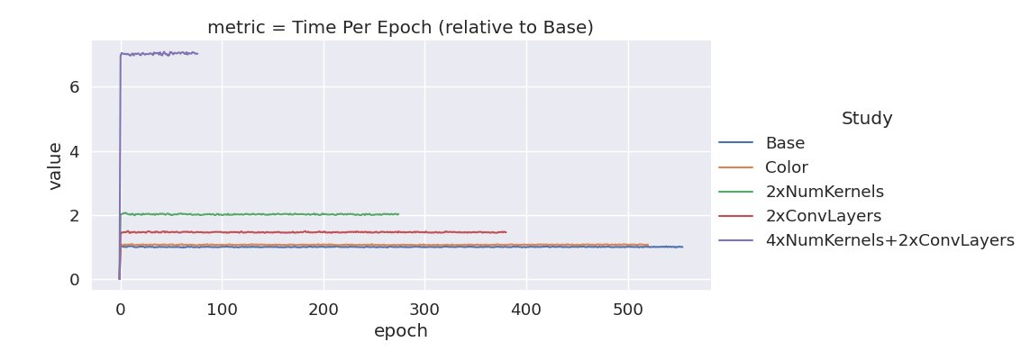
Results - Time
For our implementation, adding color channels had a negligible effect on training time.
Doubling the number of convolutional layers resulted in training that took 1.5x as long.
Doubling the number of kernels resulted in training that took 2x as long.
Our largest network took about 7x as long to train.

Slide 11
What could be future extensions of your work?
Optimizing CNN architectures further.
Integrating real-time deployment using TensorFlow Lite.
Expanding dataset for better generalization.

Slide 12
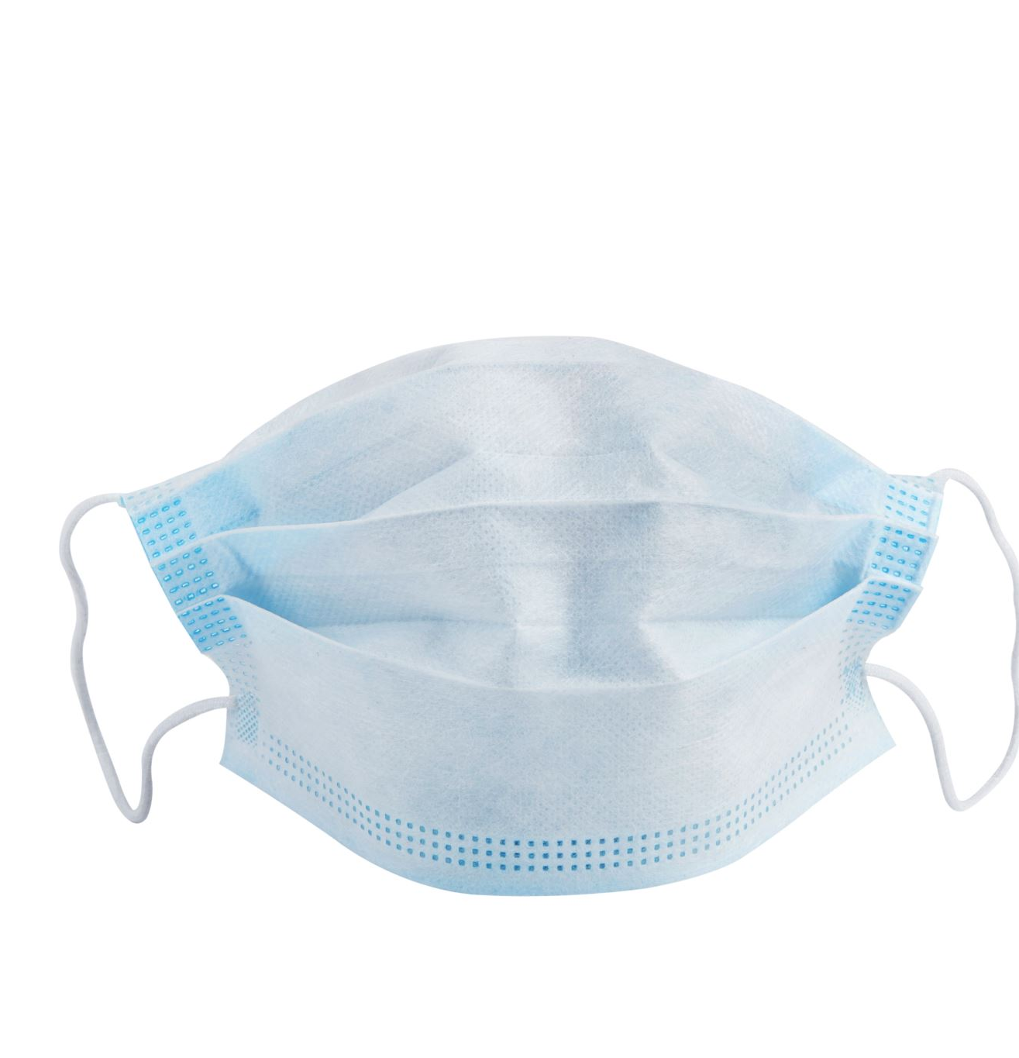
CONCLUSION
Problem: Real-time face mask detection for public health.
Data: 1360 images processed for training.
Related Work: Built on CNN foundations.
Algorithms: Five CNN variants implemented.
Results: Accuracy and training time evaluated.
Insights: Complexity vs. performance trade-offs noted.
Impact: Feasible for edge device deployment.

Slide 13
References
LeCun, Y., et al. (1998). "Gradient-Based Learning Applied to Document Recognition."
Krizhevsky, A., et al. (2012). "ImageNet Classification with Deep Convolutional Neural Networks."
Viola, P., & Jones, M. (2001). "Rapid Object Detection using a Boosted Cascade."
PyImageSearch (2020). "Face Mask Detection with OpenCV."
Glorot, X., & Bengio, Y. (2010). "Understanding the Difficulty of Training Deep Feedforward Neural Networks."

Slide 14
Thank You

